Slide 1
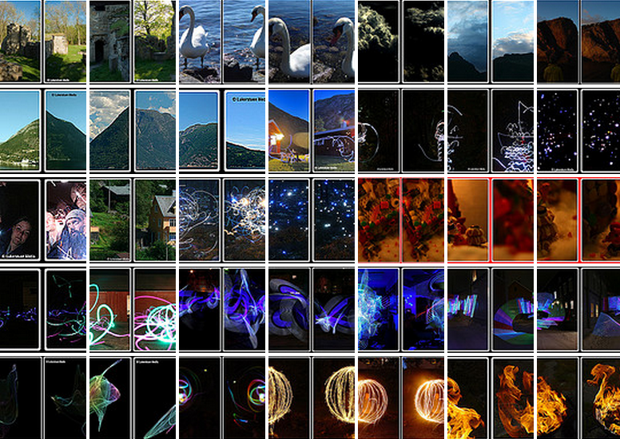
Class 4 Stereo Epipolar Geometry

Slide 2
Today
Geometry and Algebra
Projection Matrix
Computing epipolar geometry
Computing Triangulation
Correspondence
Other stereo images

Slide 3
Algebraic Formulation Pinhole Camera

Slide 4
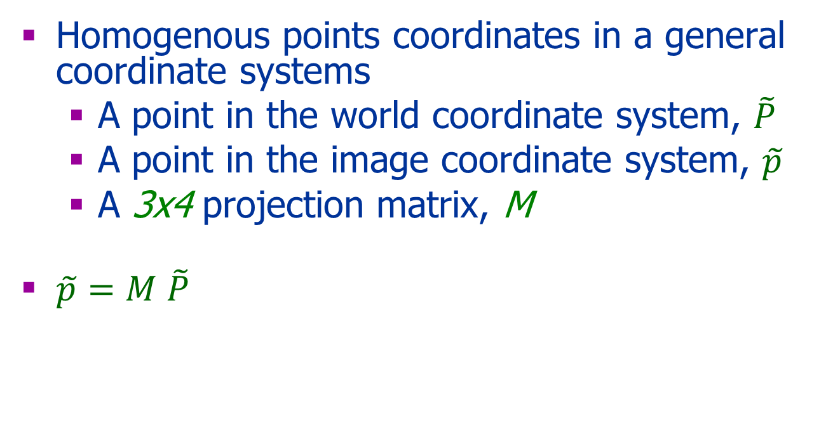

Pinhole Camera: Algebra
y
y
x
x
y
x
z

Slide 5
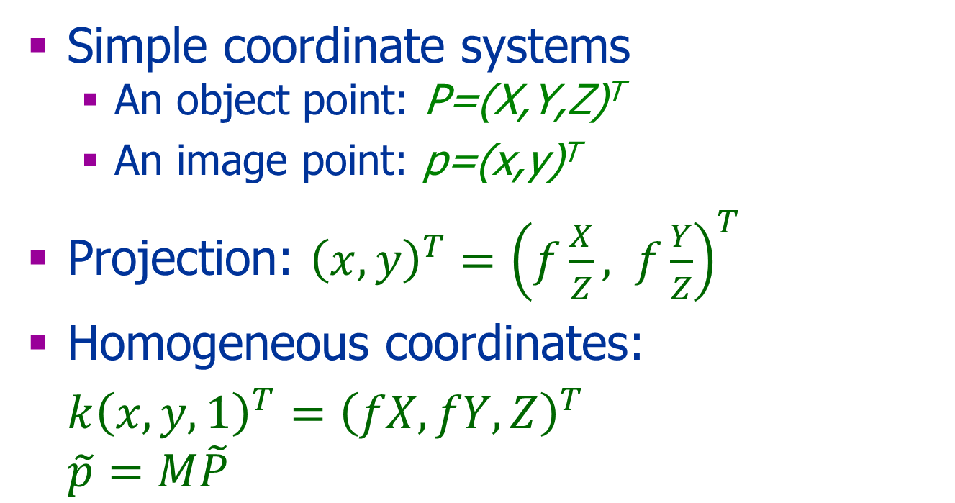

Intrinsic Parameters
y
x
y
x
z

Slide 6
Change of Image Coordinates
y
image point
x
Object point
z
Cop
(0,0,0)
y
principal axis
x
principal point
(0,0,f)
(x₀,y₀)

Slide 7
Intrinsic Parameters
O=(o_{x} o_{y})^{T} is the principal point
f : focal length
y
Y_{object}
y_{image}
z_{object}
f
O
o_{y}
x
(0,0)
o_{x,}
Computer Vision by Y. Moses

Slide 8
Principal Point Offset
Assume principal point at (o_{x},o_{y})^{T.}
P=(X,Y,Z)^{T} and p=(x,y)^{T} are related by:
Homogeneous coordinates:

Slide 9
Pixel Scaling
P=(X,Y,Z)^{T} and p=(x,y)^{T} are related by:
Homogeneous coordinates:

Slide 10
Internal Parameters
Let p be the projection of the object point P then :
where
or

Slide 11
Questions
Assume f=s_{x}=s_{y}=1 and o=(0,0)
What are the projections of:
P1=(0,0,10)^{T} → p1=?
P2=(1,0,5)^{T} → p2=?
P3=(1,0,0.5)^{T}→ p3=?

Slide 12
An Image Pair
Two coordinate systems: left and right.
C_{l}=(0,0,0)^{T} in the left system.
C_{r}=(0,0,0)^{T} in the right system.
Object Point
Left Image
Right Image
O
f
α
O
β
Cop
Cop

Slide 13
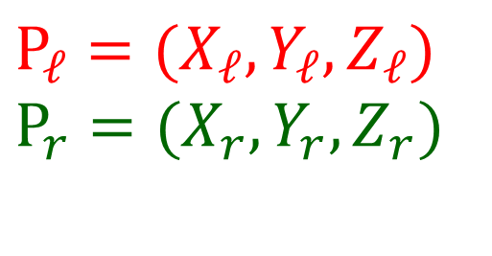
Notation
$P_{ℓ}=(X_{ℓ},Y_{ℓ},Z_{ℓ})$ $P_{r}=(X_{r},Y_{r},Z_{r})$
P P
Object point
p_{l}
+
α
β
C_{L}
+
C_{R}

Slide 14
Change of Camera Coordinates
y
y
x
x
y
Object point
x
z
(0,0,0)
Cop
(0,0,0)
principal axis
(x_{c},y_{c},z_{c})
z
principal point
(0,0,f)
(x₀,y₀,z_{o})

Slide 15
3D Rigid Transformation
Given a point in two coordinate systems:
Left coordinate system: P_{l}=(P_{l},Y_{l},Z_{l})^{T}
Right coordinate system: P_{r}=(X_{r},Y_{r}, Z_{r})^{T}
The rigid transformation between the two cameras’ coordinate systems: R, T
Then: P_{r}= R(P-T)

Slide 16
Only Translation In 2D:
T= P_{r0}⁻ P_{l0}
P_{r}= P_{l}+ T
y
y
P_{l}=[x_{l} y_{l}]^{T}
P_{r}=[x_{r} y_{r}]^{T}
x
x
x
P_{l0}=[x₀ y₀]^{T}
P_{r0}=[0 0]^{T}

Slide 17
Translation in 3D
Let T=(T_{x},T_{y},T_{z})^{T}
Nonhomegeneous: P_{r}=P_{l}-T
Homogeneous:

Slide 18
Only Rotation in 2D: P_{r}=RP_{l}
P_{r}=(x_{r} y_{r})^{T}
y
P_{l}=(x_{l} y_{l})^{T}
y
x
P_{r0}=(0 0)^{T}
α
x
P_{l0}=(0 0) ^{T}

Slide 19
Rotation in 3D
Let R be a rotation matrix (RR^{T}=I).
Inhomegeneous: P_{r}=RP_{l}
Homogeneous:

Slide 20
Translation and Rotation P_{r}=R(P_{l}-T)
y
P_{l}=[x_{l} y_{l}]^{T}
y
P_{r}=[x_{r} y_{r}]^{T}
x
P_{r0}=[0 0]^{T}
x
P_{l0}=[x₀ y₀]^{T}

Slide 21
3D Rigid Transformation
Let R be a rotation matrix, T be a translation vector
Inhomegeneous: P_{camera}=R(P_{world}-T)
Homogeneous: where

Slide 22
From Camera to Image Coordinate System
When camera and object are within the same coordinate system: where
Where the camera has a different coordinate system: where:

Slide 23
Back to Stereo

Slide 24
Stereo Main Issues
Correspondence
Geometric constraints
Local information
Global information
Calibration
Reconstruction (triangulation)

Slide 25
Tiangulation

Slide 26
A Simple Stereo System
Object point
The two camera planes are coplanar
The two optical axes are parallel
The two focal lengths are identical
The fixation point lies at infinity
The correspondence is given
f
f
Left Image
Right Image
α
β
+
+
Cop
Cop
Notes:
When the two image planes and the center of projecions are known, it is possible to compute the 3D location of a point from the two images.

Slide 27
Computing the Depth from Disparity
P
The disparity:
d =x_{l}-x_{r}
Z
Z-f
O_{L}
O_{r}
x_{l}
x_{r}
f_{l}
p_{l}
p_{r}
f_{r}=f_{l}
T
cop_{l}
cop_{r}

Slide 28
General Case Triangulation
Object Point
Left Image
Right Image
O
+
α
O
β
+
Cop
Cop
Possible to use trigonometry but projective geometry is nicer & easier
Notes:
When the two image planes and the center of projecions are known, it is possible to compute the 3D location of a point from the two images.

Slide 29
Triangulation
We are looking for P such that:
and
P is the intersection of the two lines
P(λ) and Q(λ’)
How to compute?
Q(λ)
P(λ)
Object Point
P
O
p
q
f
How to compute?
O
Cop
Cop

Slide 30
Back Projection Ray
Let M be the projection matrix
Let p be an image point
Let P be a point in 3D that project to p
The ray P(λ) is given by:
P(λ)=λC+(1- λ)P
p
P(λ)
P
C
Note: p and P are nonhomogeneous coordinates.

Slide 31
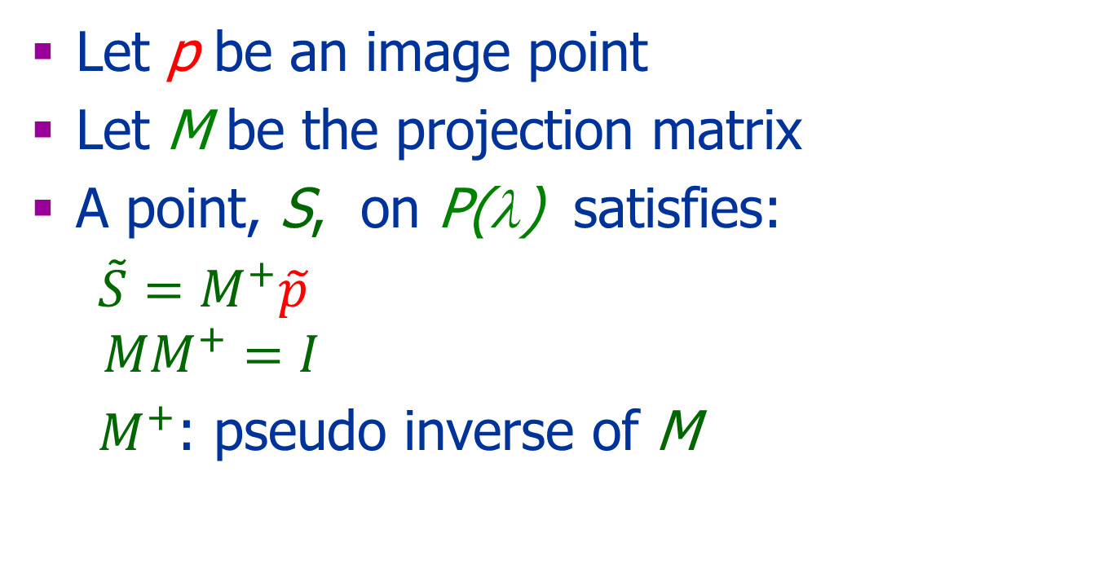
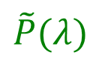

Back Projection Ray
Let p be an image point
Let M be the projection matrix
A point, S, on P(λ) satisfies:
${\tilde{S}=M}^{+}\tilde{p}$ $$MM^{+}=I$$
$M^{+}$: pseudo inverse of M
$\tilde{p}$
$\tilde{P}(λ)$
S

Slide 32
Pseudoinverse
Let A be a n×m matrix where n<m
Define A⁺=A^{T}(A A^{T})⁻¹
AA⁺= I
In our case, given an image point , and a projection matrix M, the 3D point
projects to the image point :
Note: and are homogeneous coordinates

Slide 33
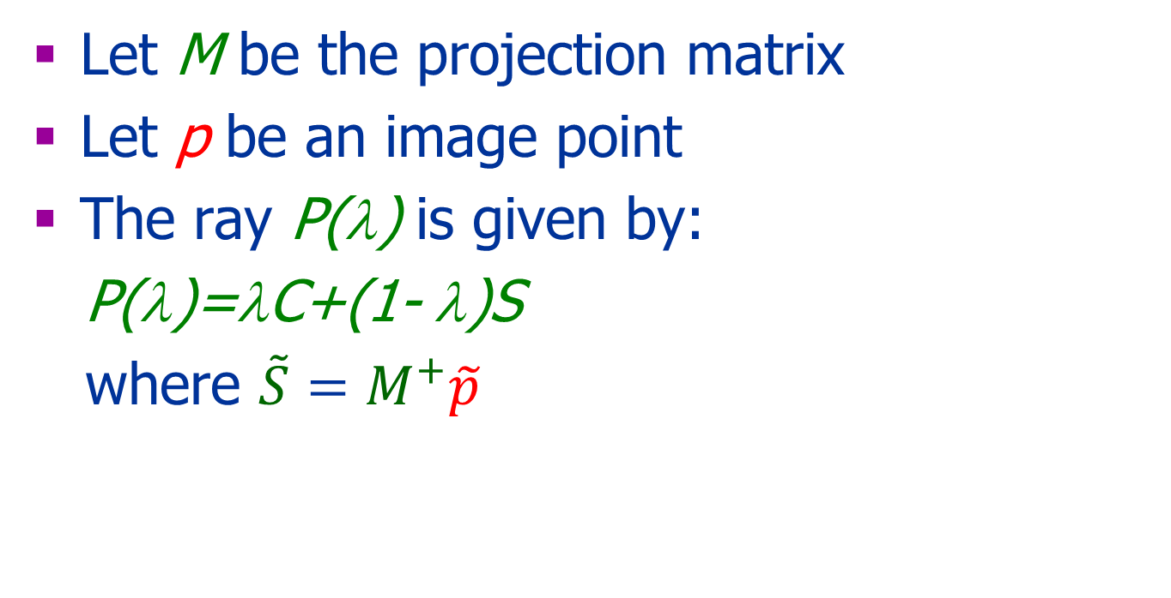
Back Projection Ray
Let M be the projection matrix
Let p be an image point
The ray P(λ) is given by:
P(λ)=λC+(1- λ)S
where ${\tilde{S}=M}^{+}\tilde{p}$
p
S
P(λ)
C

Slide 34
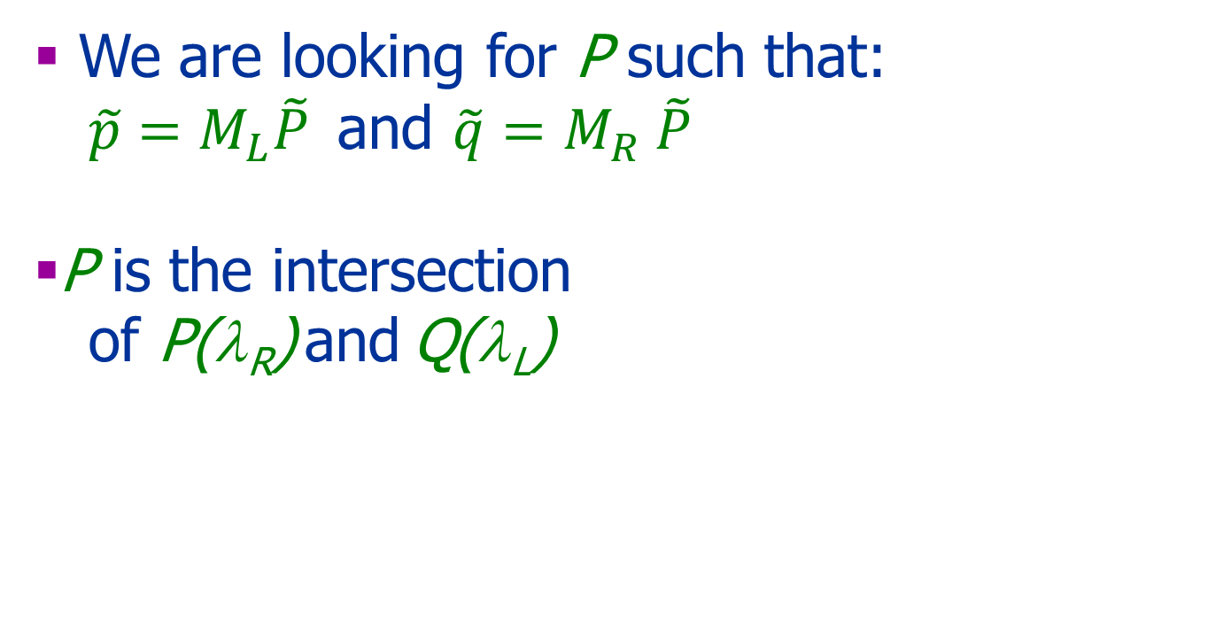
Triangulation
We are looking for P such that: $\tilde{p}=M_{L}\tilde{P}$and $\tilde{q}=M_{R} \tilde{P}$
P is the intersection
of P(λ_{R}) and Q(λ_{L})
Q(λ_{R})
P(λ_{Ll})
Object Point
P
O
p
q
f
O
Cop
Cop

Slide 35
Triangulation
When P(λ) and Q(λ’) do not intersect,
we are looking for P that minimizes:
d(P,P(λ))²⁺ d(P,Q(λ’))²
Other possibilities…
Object Point
P
O
p
q
f
O
Cop
Cop

Slide 36
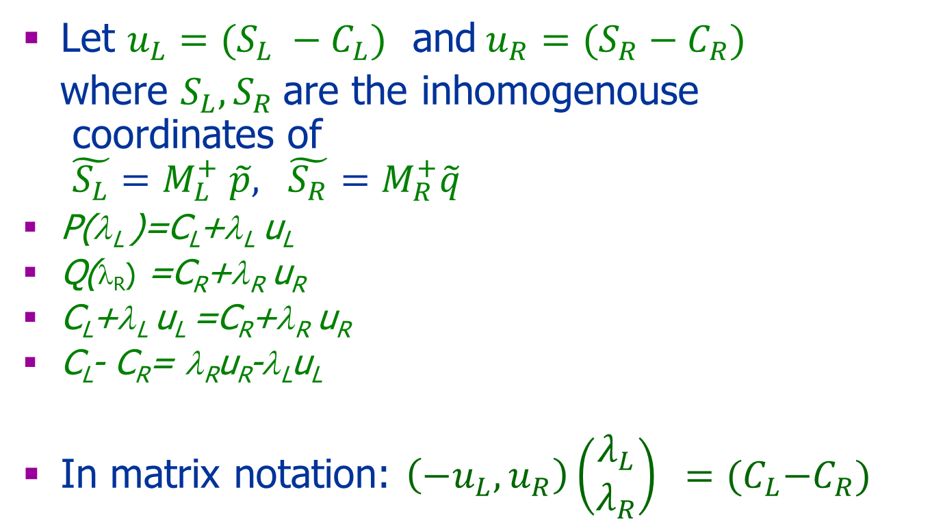
Triangulation: min(d(P,P(λ_{L}))²⁺ d(P,Q(λ_{R}))² )
Let $u_{L}=(S_{L} −C_{L})$ and$u_{R}=(S_{R}−C_{R})$
where $S_{L}, S_{R}$are the inhomogenouse coordinates of ${\tilde{S_{L}}=M}_{L}^{+} \tilde{p}, {\tilde{S_{R}}=M}_{R}^{+}\tilde{q}$
P(λ_{L} )=C_{L}+λ_{L} u_{L}
Q(λ_{R}) =C_{R}+λ_{R} u_{R}
C_{L}+λ_{L} u_{L} =C_{R}+λ_{R} u_{R}
C_{L}- C_{R}= λ_{R}u_{R}-λ_{L}u_{L}
In matrix notation: $\left(−u_{L},u_{R}\right)\left(\begin{aligned}λ_{L} \\ λ_{R}\end{aligned}\right) ={(C}_{L}−C_{R})$
P
P_{R}
Object Point
P_{L}
O
p
q
f
O
C_{R}
C_{L}
C_{R}
Notes:
the 3D location of a point from the two images.

Slide 37
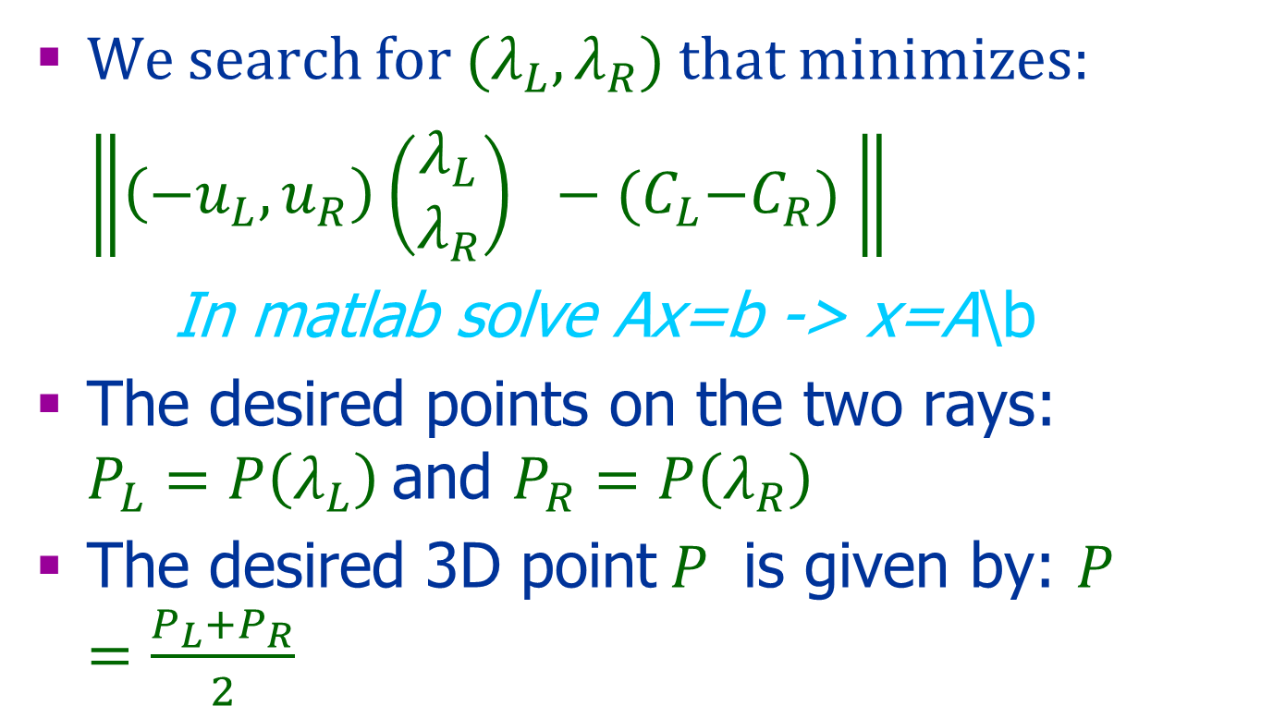
Triangulation (cont)
We search for ${(λ}_{L},λ_{R})$that minimizes:
$\left\|\left(−u_{L},u_{R}\right)\left(\begin{aligned}λ_{L} \\ λ_{R}\end{aligned}\right) −{(C}_{L}−C_{R}) \right\|$
In matlab solve Ax=b -> x=A\b
The desired points on the two rays: $P_{L}=P\left(λ_{L}\right)$and $P_{R}=P\left(λ_{R}\right)$
The desired 3D point$P$ is given by: $P=\frac{P_{L}+P_{R}}{2}$

Slide 38
Triangulation: Another Minimization
Minimize the distance of the projected point to the two image.
Choose P that minimizes:

Slide 39
The COP
The camera center, , is the null vector of M :
Let be any point in 3D
The projection of a point to the image: ,
The degree of M is 3
Choose such that
A line through and :
For each choice of , all points P(λ) are mapped to the same image point : is COP

Slide 40
Camera Calibration

Slide 41
Camera Calibration
Find the camera matrices:
Intrinsic parameters
Extrinsic parameters

Slide 42
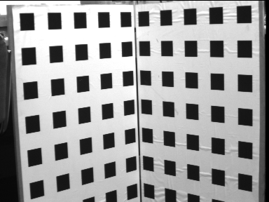
General Idea
Assumption:
Known 3D pattern
Known correspondence between image and object points
Solution:
Solve the linear equations: where p_{i} and P_{i} are known and M is unknown

Slide 43
The General Case
Equality of 2D points in the projective space: v×u=0
→ knowing p_{i} and P_{i} defines a set of linear equations in M

Slide 44
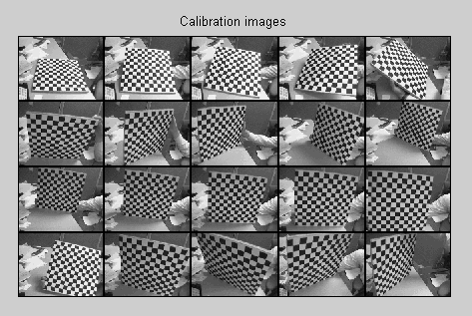
Calibration based on a planar surface
Using several images allow to compute M and their location with respect to each other

Slide 45
Correspondence

Slide 46
Correspondence: Geometry
+
+

Slide 47
Epipolar Geometry

Slide 48
Epipolar Lines
Objet point
+
+
Center of
projection
Center of
projection

Slide 49
Epipolar Geometry
A pair of corresponding points must lay on corresponding epipolar lines
Epipolar Plane
Left Image
Right Image
Epipolar line
Epipolar line
COP
Baseline
COP

Slide 50
The epipole points are e_{l} and e_{r}
Object Point
Left Image
Right Image
α
β
COP
e_{l}
e_{r}
COP
Notes:
When the two image planes and the center of projections are known, it is possible to compute the 3D location of a point from the two images.

Slide 51
Epipole
The Epipole is the projection of the cop of the other camera
Except for the epipole, only one epipolar line goes through any image point
All the epipolar lines go through the epipole

Slide 52
Epipole
What happens when the two camera planes are parallel?

Slide 53
Example: Converging Cameras

Slide 54
Example: Pure translation

Slide 55
The Fundamental Matrix

Slide 56
The Fundamental Matrix, F
F is a 3×3 matrix of rank 2
Let p_{L} and p_{R} be corresponding image points:
Each point in one image defines the epipolar line in the other image: and
F is based on intrinsic and extrinsic parameters

Slide 57
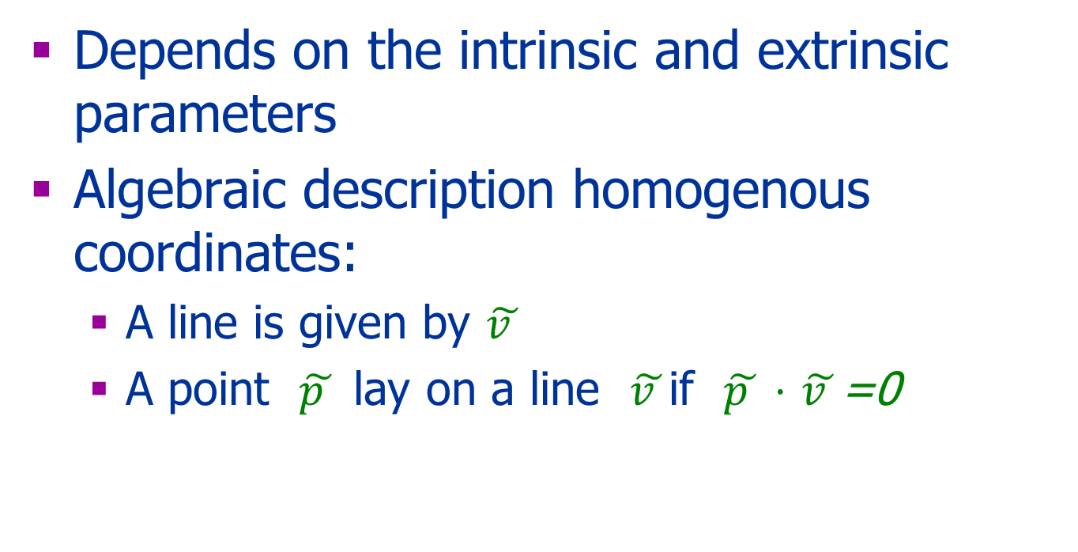
Determining the Epipolar Lines
Depends on the intrinsic and extrinsic parameters
Algebraic description homogenous coordinates:
A line is given by $\tilde{v }$
A point $\tilde{p }$ lay on a line $\tilde{v }$if $\tilde{p }⋅$ $\tilde{v }$=0

Slide 58
Computing F
Let M_{L} and M_{R} be the projection matrices
A point in 3D that projects to p_{l}
Its projection to the right image
The line in the right image
u
P
p_{l}
p_{r}
Cop_{r}
Cop_{l}
e_{l}
e_{r}
β
Left Image
Right Image
Notes:
When the two image planes and the center of projections are known, it is possible to compute the 3D location of a point from the two images.

Slide 59


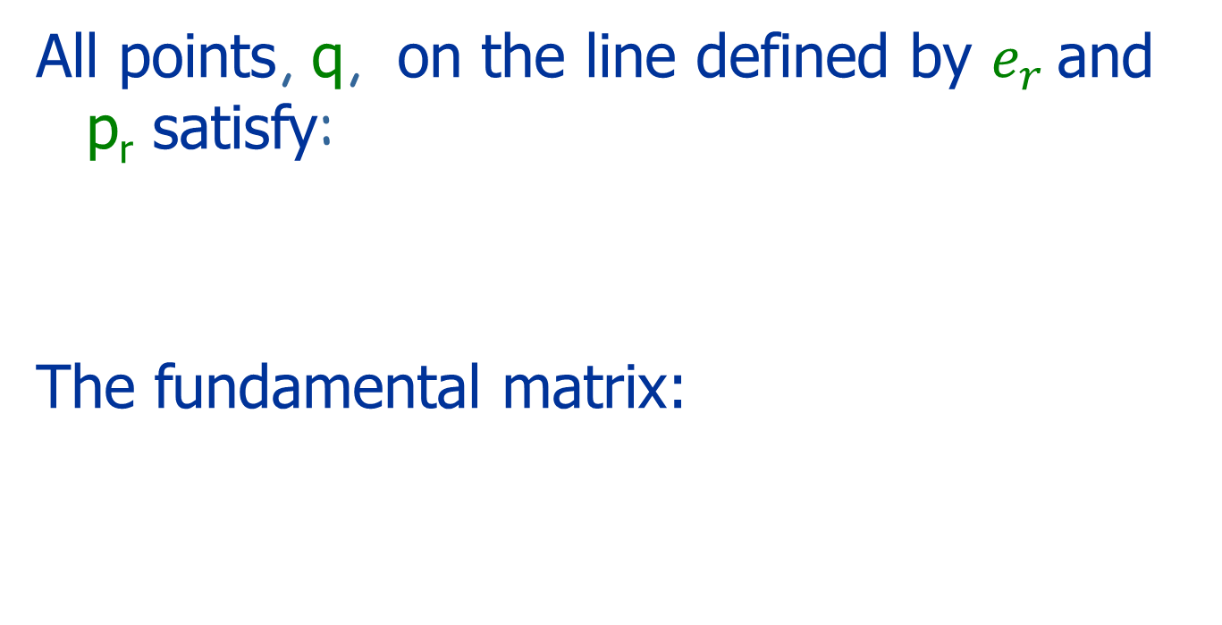
Computing F
All points, q, on the line defined by $e_{r}$ and p_{r} satisfy:
The fundamental matrix:
$$T$$
$$T$$
u
P
p_{l}
p_{r}
Cop_{l}
e_{l}
e_{r}
β
Cop_{r}
Left Image
Right Image

Slide 60
Vector Product
*
v
*
u
uxv
*
where

Slide 61


Summary Fundamental Matrix
If p_{L} and p_{R} are corresponding image points then
Epipolar lines: and
The epipoles: and
$$T$$
$$T$$

Slide 62
A Special Case: Pure Translation
Assume:
The world coordinate system is the left camera’s system
Both cameras have the same intrinsic projection matrix
The right camera is only translated in the x direction
Then:

Slide 63
A Question
What is kF?

Slide 64
Computing F
Given the internal and external parameters of the cameras:
When the cameras’ parameters are unknown: use 8 (or more) corresponding points

Slide 65
Computing F
Assume n≥8 corresponding points are given
Use these points to solve the 8 unknowns of F based on:
Avoid degenerate configurations

Slide 66
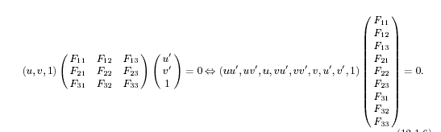
Eight Points Algorithm
Each pair of corresponding points defines one linear equation in 8 unknowns

Slide 67
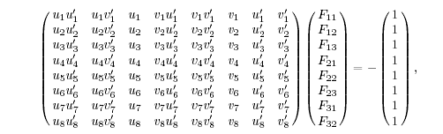
8 pairs of corresponding points define eight linear equations in 8 unknowns
Solve the linear equations and find F

Slide 68
Improve the 8 points algorithm
F has rank 2
Enforce the rank 2
E.g. Hartley 1995

Slide 69
Rectification
Simplify the use of epipolar lines
u
P
p_{l}
p_{r}
C_{l}
C_{r}

Slide 70
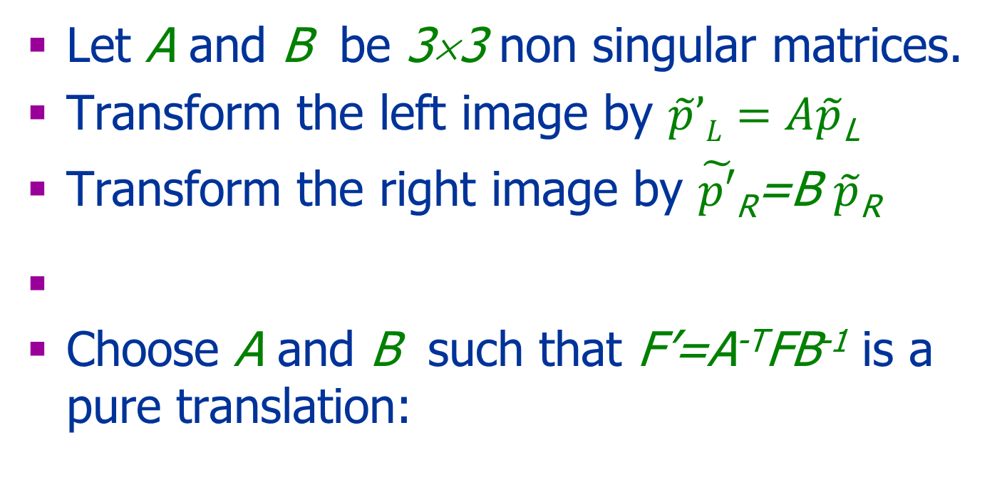
Rectification
Let A and B be 3×3 non singular matrices.
Transform the left image by $\tilde{p}’L=A\tilde{p}$_{L}
Transform the right image by $\tilde{p′}$_{R}=B $\tilde{p}$_{R}
Choose A and B such that F’=A^{-T}FB⁻¹ is a pure translation:

Slide 71
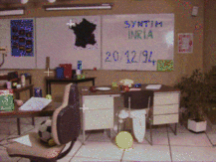
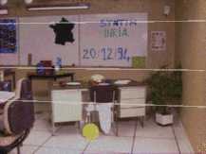
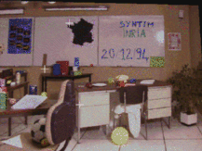
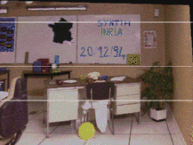
Rectification
Taken from: SYNTIM-INRIA.

Slide 72
More on Correspondence

Slide 73
Correspondence
Similarity of patches
Geometric constraints:
Epipolar geometry
Global constraints:
Shape smoothness
Order preserving
..

Slide 74
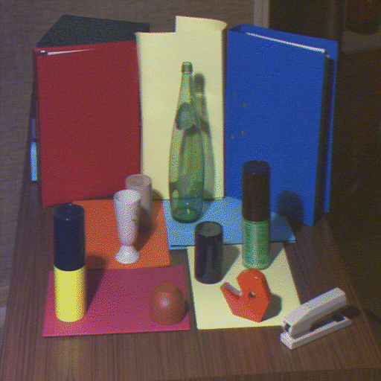
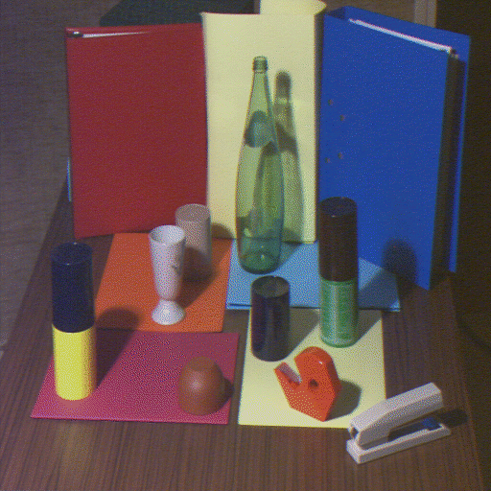
Points Attribute Constraints
A pair of corresponding points must have the same physical origin
Both are located on an edge due to a surface discontinuity, a shadow border, an occluding boundary, etc.

Slide 75
Occlusion
Occluded in
Right Image
Occluded in
Left Image
Right
Left
+
+
Center of
projection
Center of
projection

Slide 76
Uniqueness Constraint
Each pixel can correspond to at most one pixel in the other image
No transparency
No two or more points
project to the same point

Slide 77
Ordering Constraints
Corresponding points of similar depth typically maintain their order on the epipolar lines
This assumption does not hold when there is a depth discontinuity
p
q

Slide 78
Disparity Smoothness Constraint
The disparity changes slowly almost everywhere in the image
True since the depth changes slowly almost everywhere in the 3D scene

Slide 79
Mutual Correspondence Constraint
The existence of a correspondence between points does not depend on whether we start from the left image or the right image

Slide 80
Correspondence Optimization
Local greedy matches:
Low-level: Bottom up methods are based on local attributes of points
1D search
2D search:
High-level: Minimizing an energy function that represents global and local properties of the surface (e.g., smoothness)

Slide 81
High Level Energy Function
Assume rectified images:
weight
Data Term
Regularization

Slide 82
1D: Dynamic Programing
Right
occlusion
p
Left occlusion
correspondence
t
s
q

Slide 83
Other Pairs of Images

Slide 84
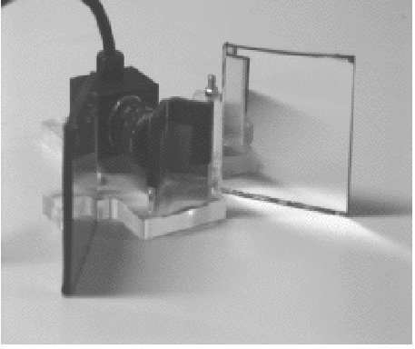
Mirrors
Taken from Mathieu and Devernay INRIA

Slide 85
Structured Light
known camera and projector geometry
Depth can be recovered by triangulation

Slide 86
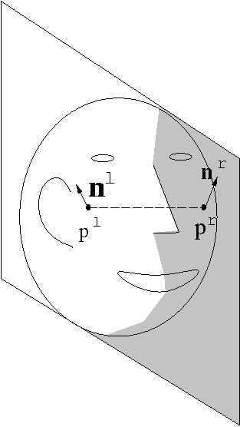

Bilateral Symmetry

Slide 87
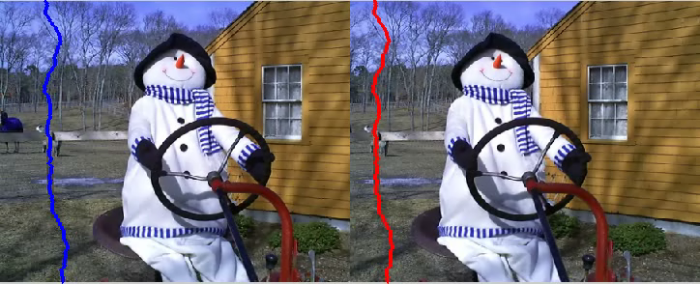
Stereo SC

Slide 88


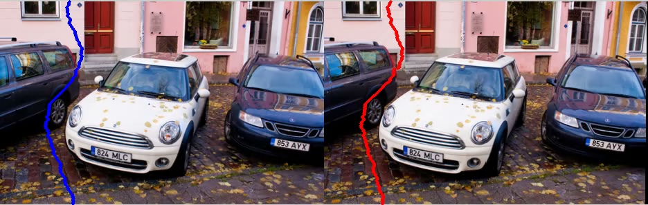
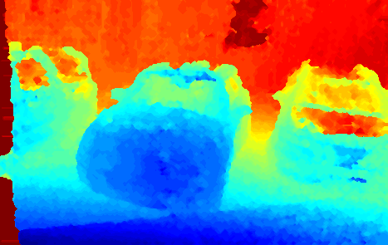

Slide 89
Uncalibrated Stereo
Calibration is necessary to determine absolute 3D positions
We can determine relative 3D positions (up to a scale factor) without calibration

Slide 90
What if we do not know the external parameters?
P
The disparity:
d =x_{l}-x_{r}
Z
O_{L}
O_{r}
x_{l}
x_{r}
f_{l}
p_{l}
p_{r}
f_{r}=f_{l}
T
cop_{l}
cop_{r}

Slide 91
A Priory Knowledge
Intrinsic and extrinsic parameters
Intrinsic parameters
No information about parameters
3D-Reconstruction From 2 Views
Unambiguous
Up to unknown scaling factor
Up to unknown projective transformation

Slide 92
Stereo Summary
Triangulation
Correspondence
Epipolar geometry+ heuristics
Calibration
Remember: 3D reconstruction is possible only from 2 independent images

Slide 93
Next
Homography
More than 2 images:
Structure from motion
Other applications of Epipolar Geometry

